Slide 1



GROUP 2
Customer Churn Prediction
Dataset: Telco Customer Churn – Kaggle
Task Flow: Model → Package → Docker → MLflow → AWS
TEAM MEMBERS
Sreeja Roy - 24030242066
Sumit Jangale - 24030242070
Palak Ghorpade - 24030242079

Slide 2

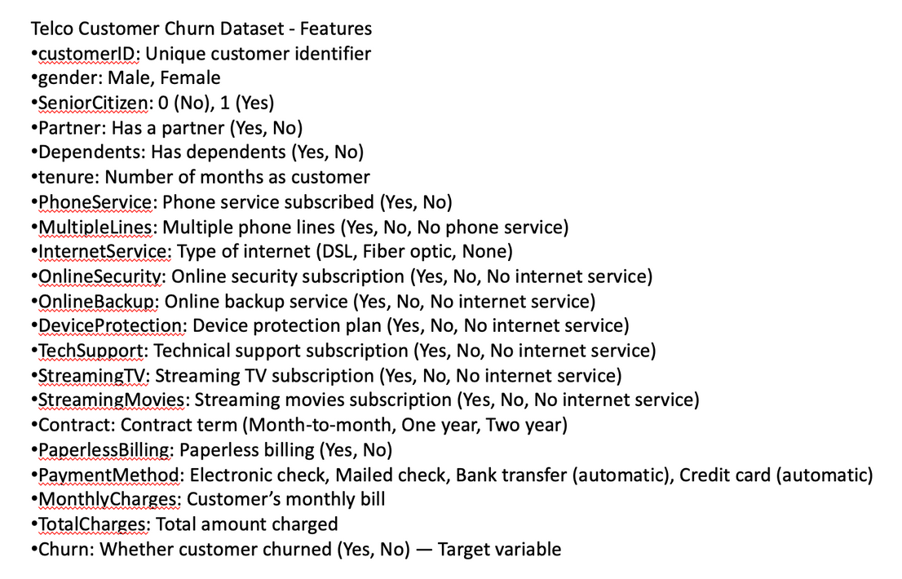

Problem Statement & Objective
Churn = customer leaves telecom service
Cost of losing customers > cost of retaining them
Objective: Predict churn and help company take proactive steps
Dataset Overview
Rows: 7,043 customers
Columns: 21 features + churn label
Categories of features:
Demographics (gender, senior citizen, dependents)
Services (phone, internet, streaming, etc.)
Billing & Contracts (tenure, payment method, charges)
Target: Churn (Yes/No)

Slide 3
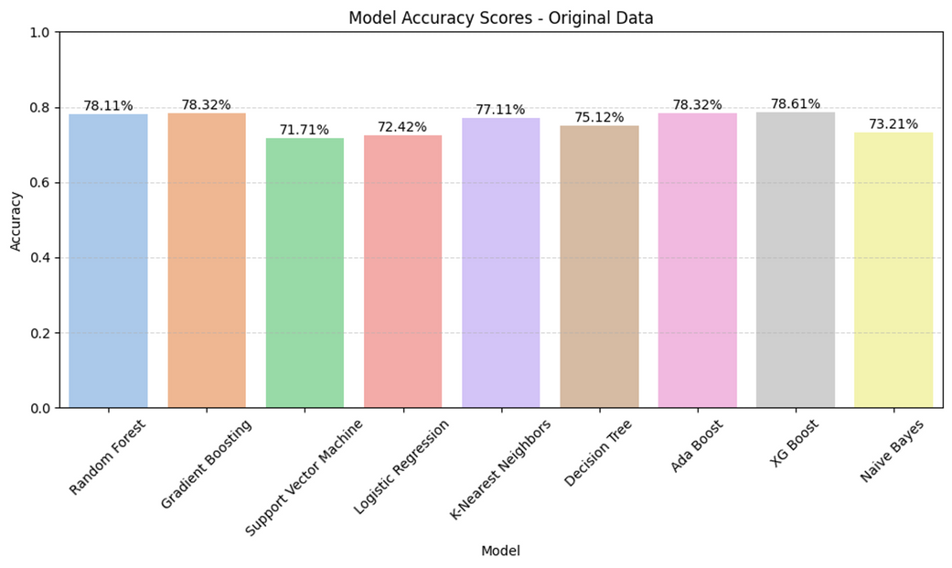

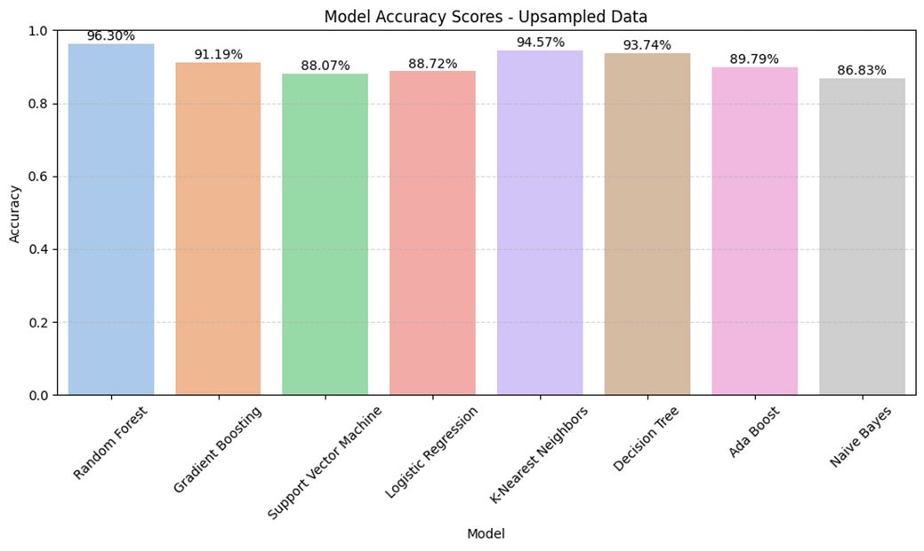
Data Preparation & Model Development
Cleaned data: handled missing values
Converted categorical features → numeric (Yes/No → 1/0)
Scaled continuous features (monthly & total charges)
Balanced churn classes using resampling
Algorithms tested: Logistic Regression, Random Forest, Gradient Boosting
Metrics: Accuracy, Precision, Recall, F1-score
Final best model chosen based on balance between precision & recall

Slide 4
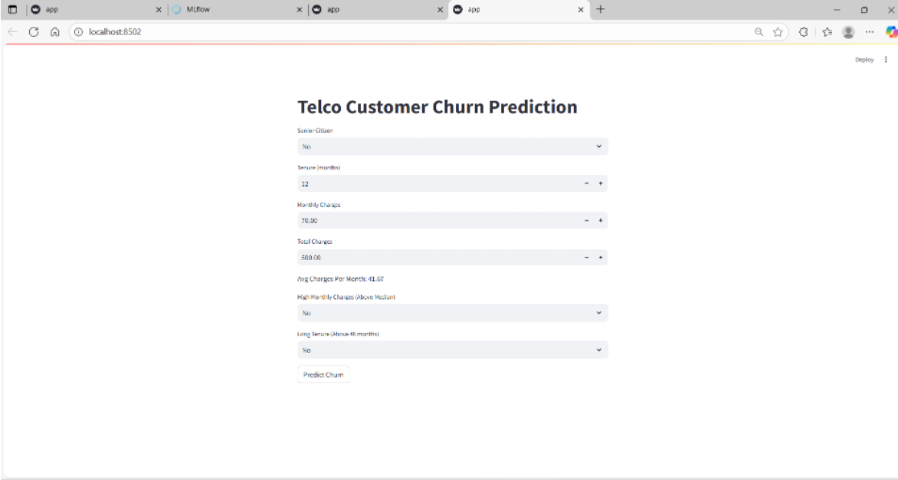
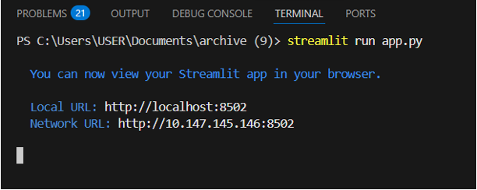
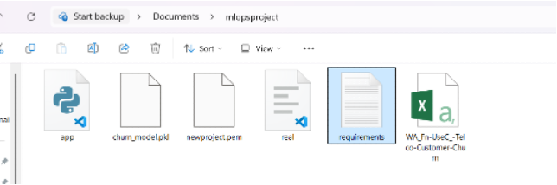
Streamlit Interface
Simple user interface for predictions
User enters details → System predicts churn (Yes/No)
Intuitive and easy to use

Slide 5
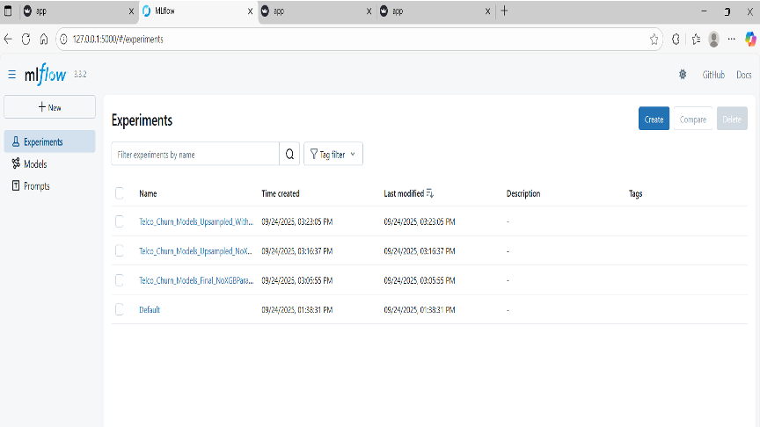


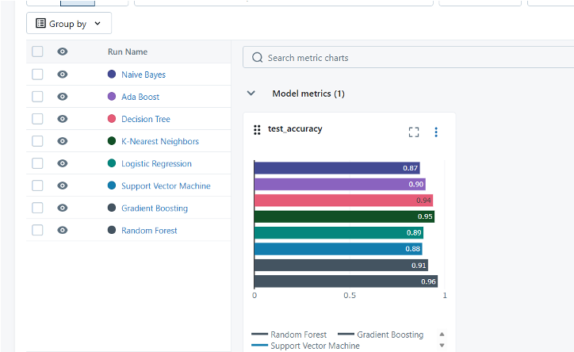

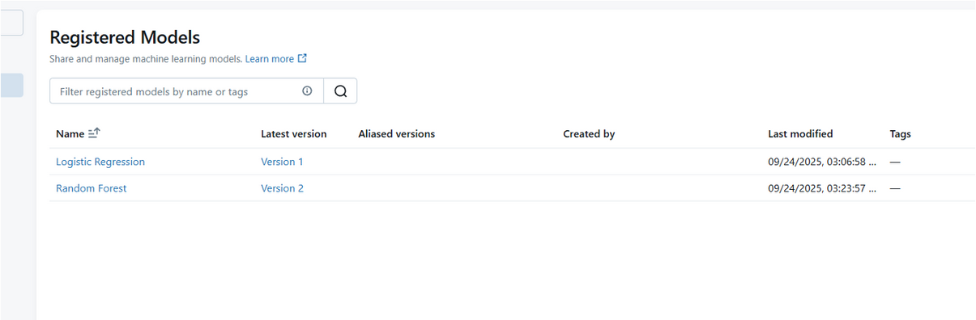
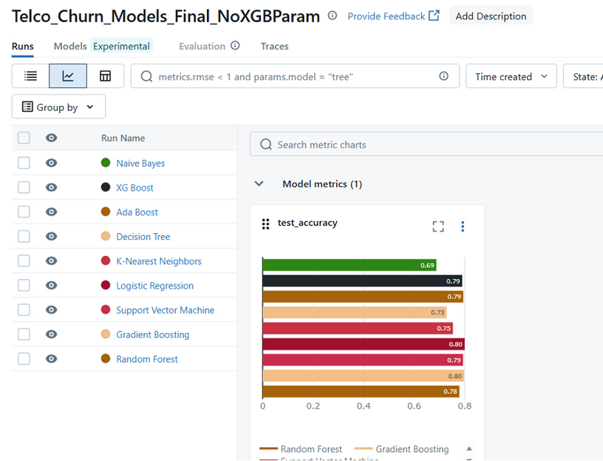
MLflow Tracking
Logged experiments with MLflow
Tracked metrics, hyperparameters, versions
Registered best model for deployment

Slide 6

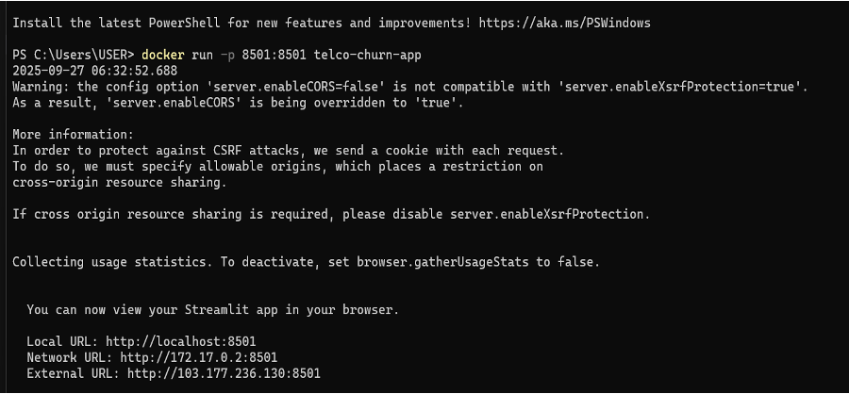
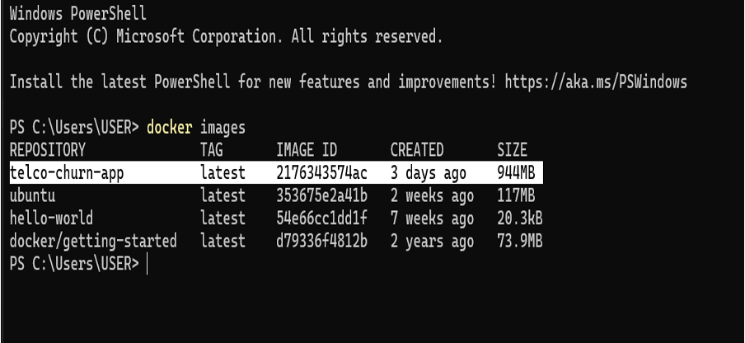
Docker Deployment
Created Dockerfile
Containerized app → Portable across systems

Slide 7

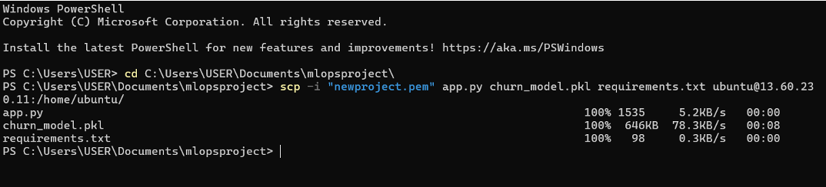

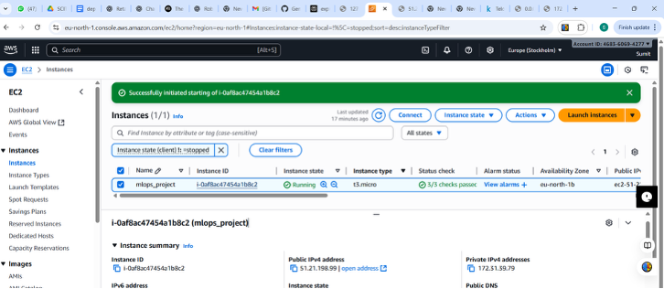
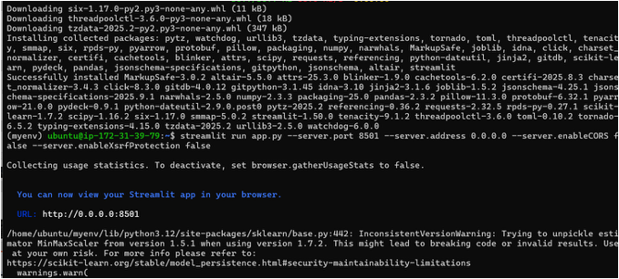

AWS EC2 Deployment
Deployed container on AWS EC2
Model accessible as web service

Slide 8

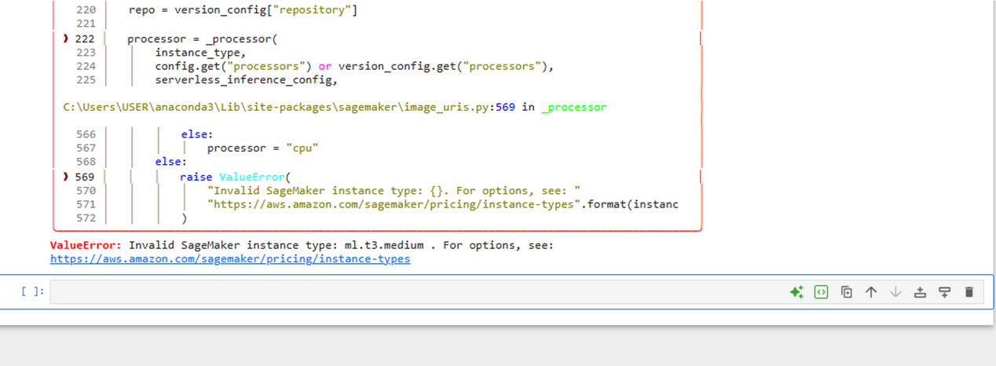
Amazon SageMaker
Tried Amazon SageMaker for managed ML deployment
Could not proceed: Free instances not available

Slide 9
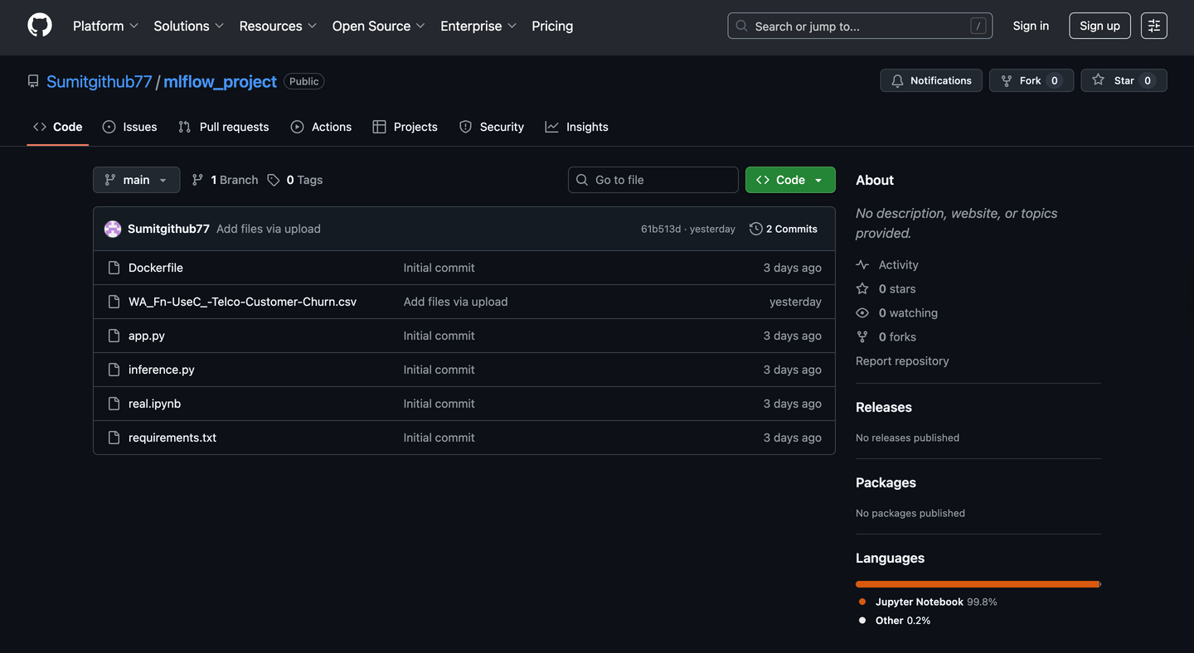
GitHub Submission
All project files uploaded on GitHub
Dockerfile
app.py (Streamlit app)
churn_model.pkl (trined model)
real.ipynb (model training notebook)
requirements.txt (dependencies)
Dataset (CSV)
Ensures version control, collaboration, and transparency
Easy access for review and reusability

Slide 10


Results, Insights & Conclusion
Top churn drivers:
Month-to-month contract → High churn
Electronic check payment → High churn
Short tenure customers → High churn
Outcome: Working churn prediction system deployed on cloud
Future scope: Real-time monitoring, SHAP/LIME explainability, deep learning models

Slide 11

THANK YOU
~ GROUP 2

